Slide 1
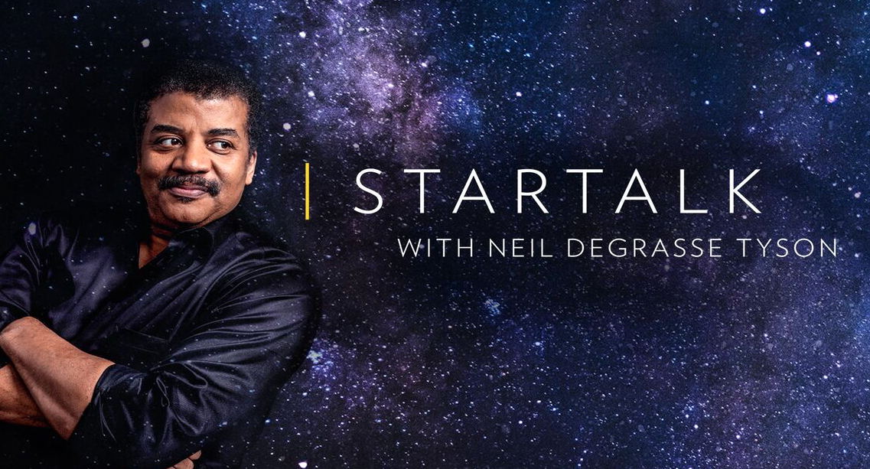
Summarising Startalk
Miniproject 3 July 2024
Jeremy Roscoe

Slide 2


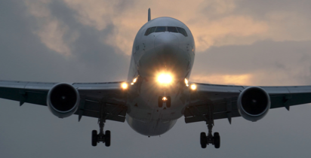
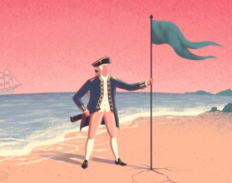
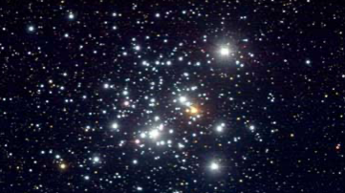

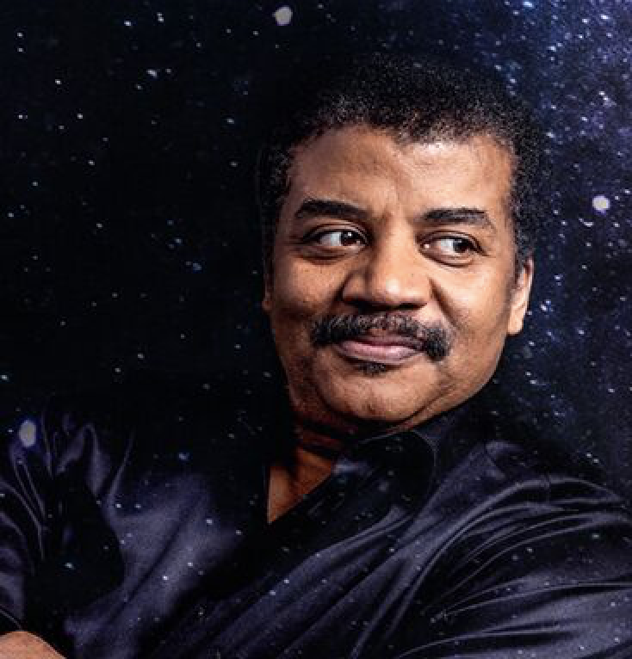
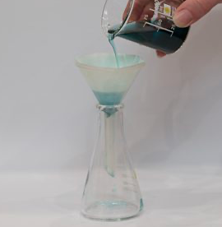


Agenda
Background
Goals
Approach
EDA
Clustering
Filtering
Insights
Application
Growth

Slide 3
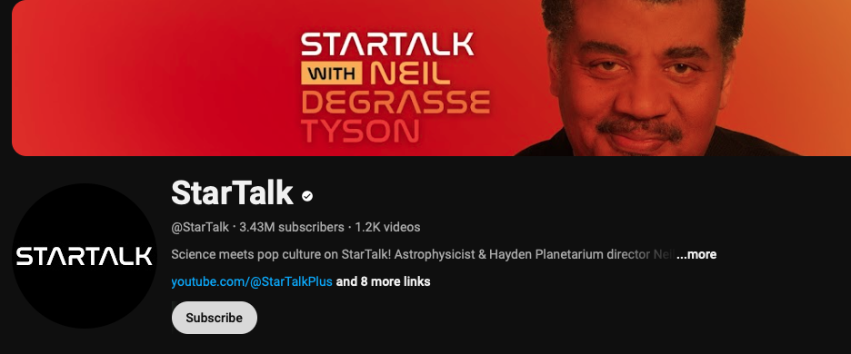
Background
https://www.youtube.com/@StarTalk
What is Startalk with Neil DeGrasse Tyson?
Why is it relevant?
Who would be interested?
Where’s the issue?
It’s a podcast, how does text come into it?
Podscribe - transcription service
https://app.podscribe.ai/series/372
Notes:
StarTalk is a podcast on science, comedy, and popular culture hosted by astrophysicist Neil deGrasse Tyson, with various comic and celebrity co-hosts and frequent guests from the worlds of science and entertainment. It has garnered many spinoffs and tv shows as well as live performances. Whilst the show covers a wide range of topics, it alo gives a platform for scientists working on the frontiers of their fields to communicate where things are going and bring about awareness of otherwise specialised niches.

Slide 4
Goals
Save the time of listening to the entire episode
Save having to digest every statement for relevance
Ultimately: a concise scientific summary of updates and knowledge in STEM fields from the podcast
Find a robust approach to avoid continual retraining for new episodes
Filter out comedic banter and redundant explanations

Slide 5
Approach
Cleaning
EDA
Engineering
Vectorising
Clustering
Application
Filtering
Evaluating
Predicting
?
Notes:
From raw transcripts:
Cleaning (remove ads and structure data)
Explore the datasets
Engineer (break into sentences split/merge/label)
Vectorise
Clustering - pattern recognition groupings
Predicting - mapping clusters to new episode
Evaluating train/test split on labelled episode
Filtering raw transcripts into concise inputs
Application of a text generator
to a column/ app/ website

Slide 6
Approach
Techniques:
EDA with WordCloud
Parts of speech with regex and spacy
TF-IDF on token and n-gram levels
Word counts with CountVectorizer
Word embedding with Word2Vec
Hierarchical Dbscan and prediction with hdbscan
Homogeneity Analysis
Recall and accuracy analysis
LLM prompting and text generation with mistral

Slide 7
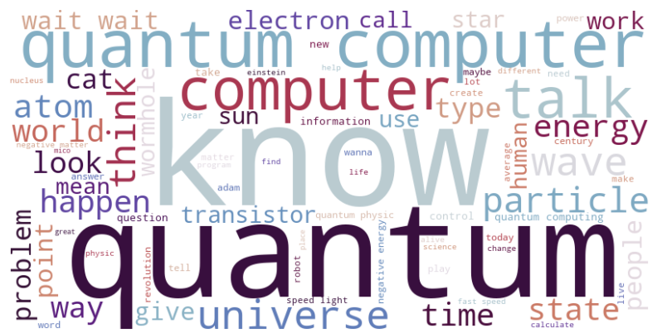
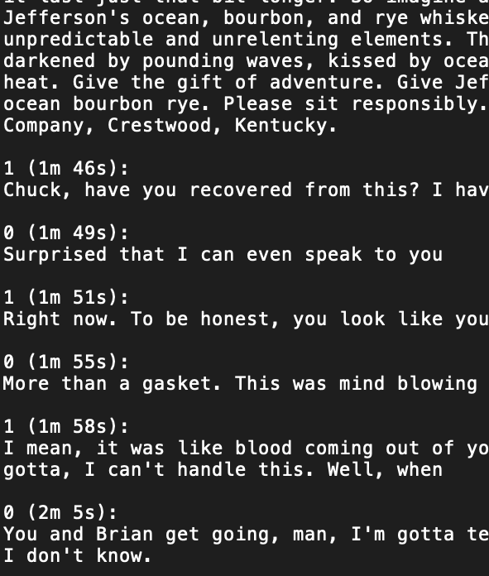
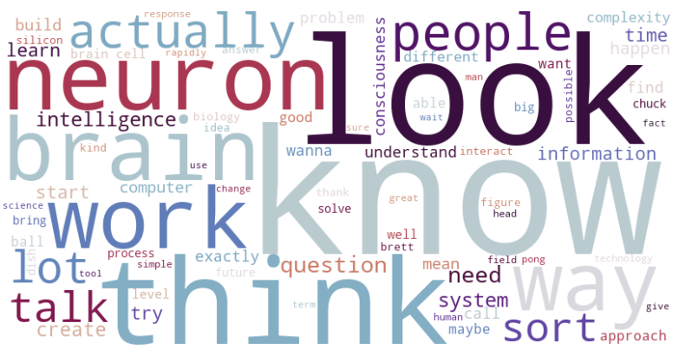
EDA
5 episode transcripts
Quantum Computing Corral_ StarTalk Live! With Michio Kaku
Synthetic Biological Intelligence with Brett Kagan
The Magic of Chemistry with Kate the Chemist
Just Another Really Good Episode with Brian Greene
Cosmic Queries – Single Electron Universe with Charles Liu
Notes:
Raw transcript is a text file with ads, assigned speaker labels, time stamps and text
Quantum computing corral is a live episode and was manually labelled for statement relevance

Slide 8
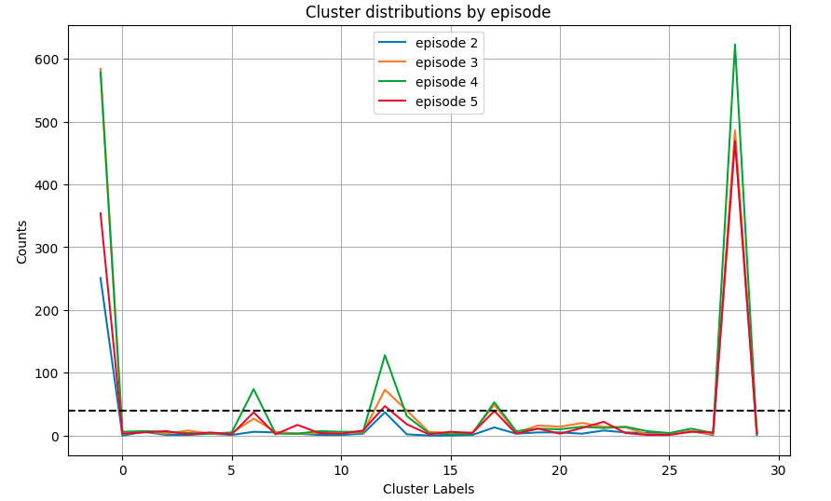
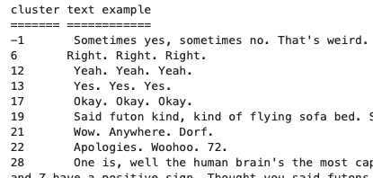
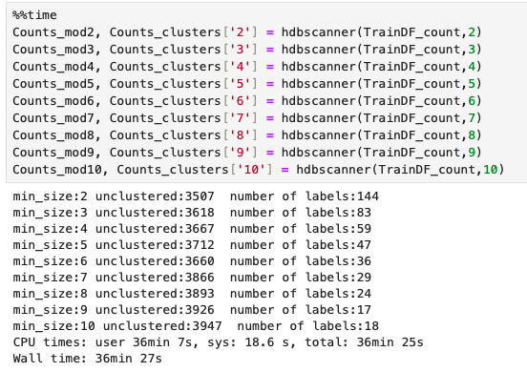
Clustering
HDBSCAN over a range of cluster sizes on:
Parts of Speech
Word Counts
Word TF-IDF
n-gram TF-IDF
Word Embedding:
3-word window
6-word window
For 4 out of the 5 episodes
Notes:
* -1 label for noise (ungrouped) often specific statements
* larger clusters had consistency across episodes and had what would be classified as irrelevant

Slide 9
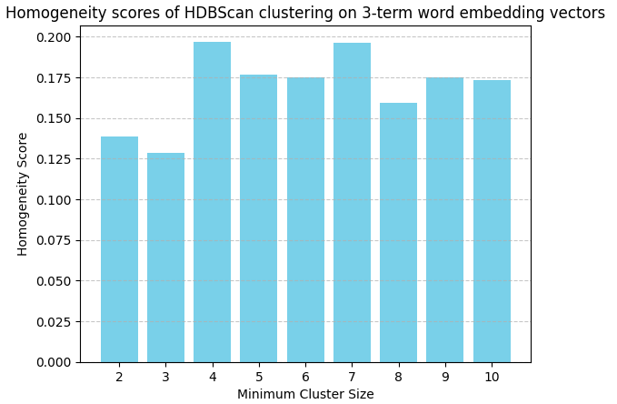
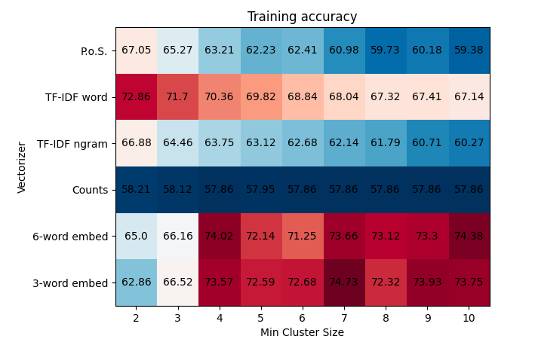
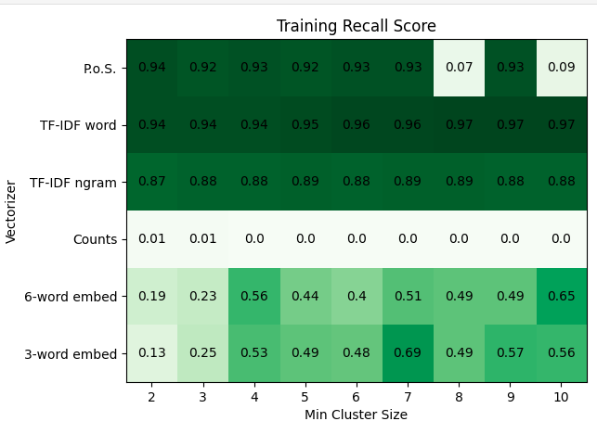
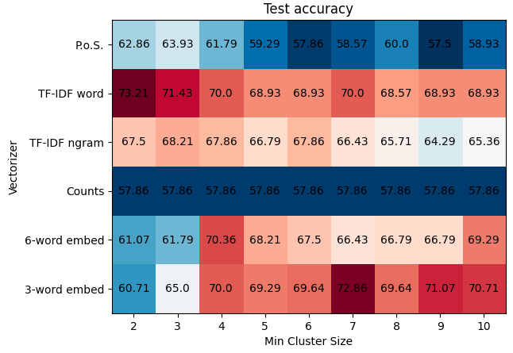
Filtering
Notes:
Homogeneity is between 0 and 1 note the low scores.

Slide 10
Insights
Recall is the more important metric here
A little extra irrelevance is not as important as missing key statements
Banter is more easily grouped
Colloquial phrases are often repeated and similar – Ok , yeah, alright wow
Even with a small training corpus and crude mapping, attained 73% accuracy on test data
Small cluster TF-IDF word and higher cluster 3-term word embeddings were the best models in this group
Effective summarisations of an informationally sparse episode are possible with the right clustering tools
…

Slide 11
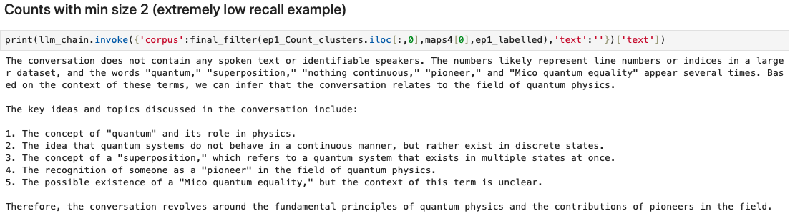
Application
- A Poor model

Slide 12
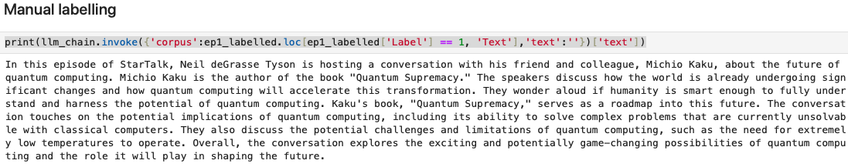
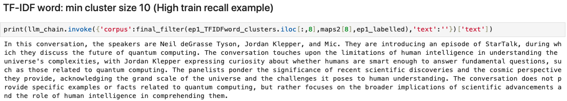
Application

Slide 13
Growth
Expand training and supervised learning
Streamline the pipeline
App creation potential
Identification of broken speech and gap filling
Thank you and keep looking up!

